Slide 1

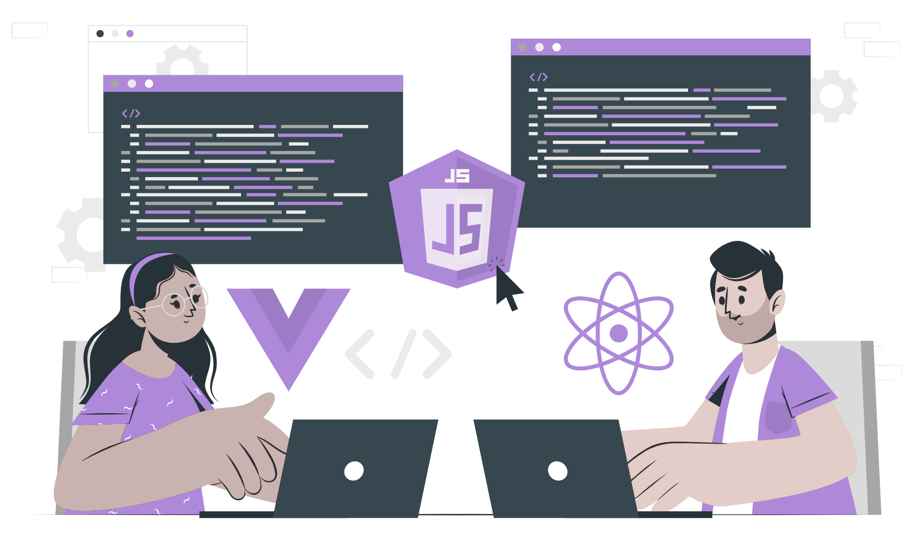
File system module

Slide 2
List of content:
What is a file system
Opening a file
Reading a file
Writing to a file
Appending to a file
Closing a file
Deleting a file

Slide 3
File System
Node.js is a platform that uses Chrome's V8 JavaScript engine, allowing developers to use JavaScript to create server-side applications that generate dynamic content for web clients. What sets Node.js apart are its event-driven and non-blocking I/O features.
Node.js includes a built-in module called FS (File System) that allows users to manage files by creating, reading, deleting, and performing other file operations.
To use this module, developers can call the "require()" method, which provides access to POSIX functions wrapped by Node.js to enable both synchronous and asynchronous file system operations, depending on the user's requirements.
var fs = require('fs');

Slide 4
Synchronous vs Asynchronous approach :
The Synchronous approach involves blocking functions that wait for each operation to complete before executing the next one. This means that a command won't execute until the query has finished executing and all the results from previous commands have been obtained.
On the other hand, the Asynchronous approach involves non-blocking functions that execute all operations at once, without waiting for each operation to complete. The results of each operation are handled when they become available, and each command is executed after the previous one. If the operations involve querying large amounts of data from a database, the Asynchronous approach is recommended.

Slide 5
Common use for File System module:
Read Files
Write Files
Append Files
Close Files
Delete Files

Slide 6
Opening a file

Slide 7
Reading a file

Slide 8
Writing to a file

Slide 9
Appending to a file

Slide 10
Closing a file

Slide 11
Deleting a file

Slide 12
THANK YOU

